Slide 1
QUIZ GAME APPLET
COMPUTER PROGRAMMING PROJECT
Developers:
-Puno, Rose Anne
-Socias, Joshua
-Flores, Jill
-Punay, Thea Marie

Slide 2
IQ TEST QUIZ
Is an INTELLIGENCE QUOTIENT designed to assess human intelligence.
IQ test quiz app can generate challenges
Accepts user Information
Play games by answering the questions
Test your knowledge
Different types of questions
Gives you a high score.

Slide 3
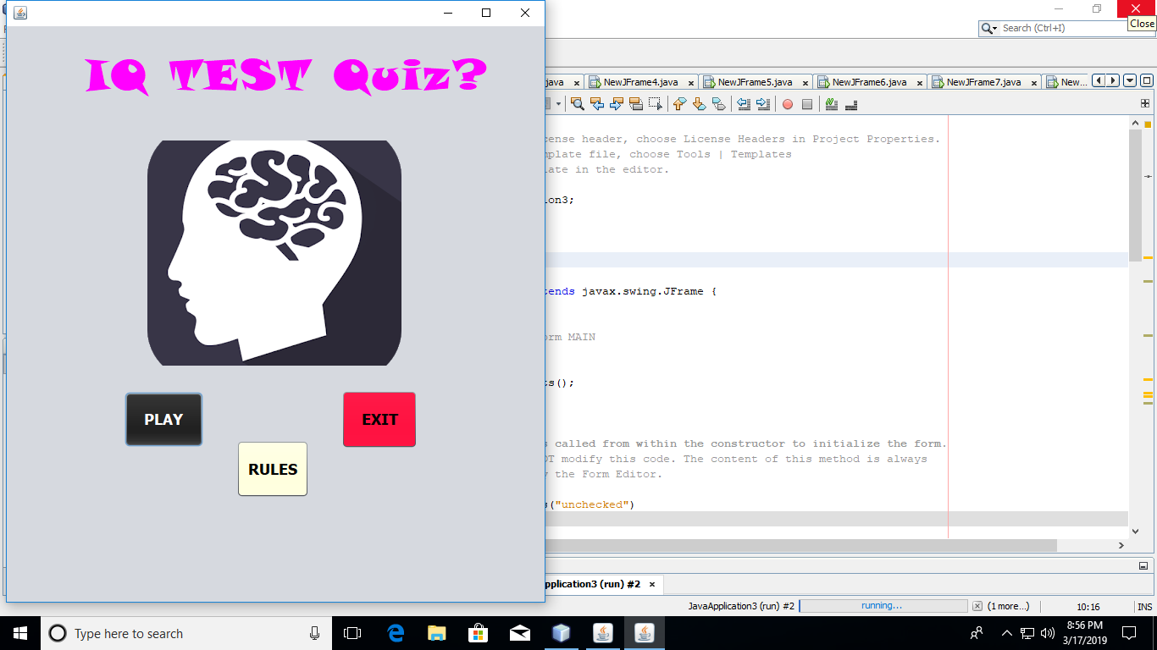
PROTOTYPE
NETBEANS IDE

Slide 4
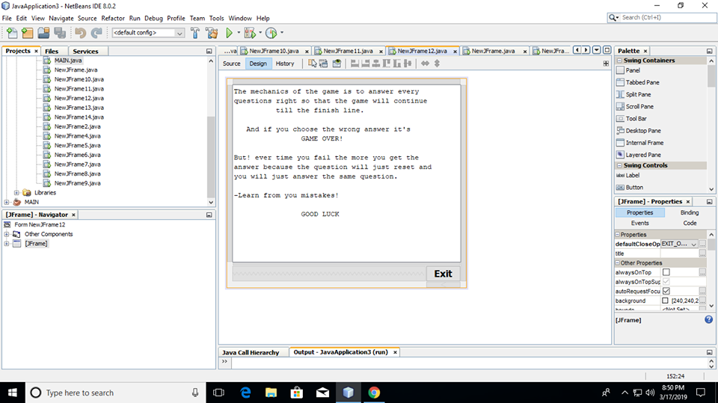
SINCE OUR APPLET IS A GAMES WE MADE A RULE. AS YOU CAN SEE IN OUR FIRST PICTURE IT DISPALYS OVER THERE THE “PLAY, RULE, AND EXIT. SO HERE IS THE RULE IN THE GAME IF YOU WANT WIN.

Slide 5
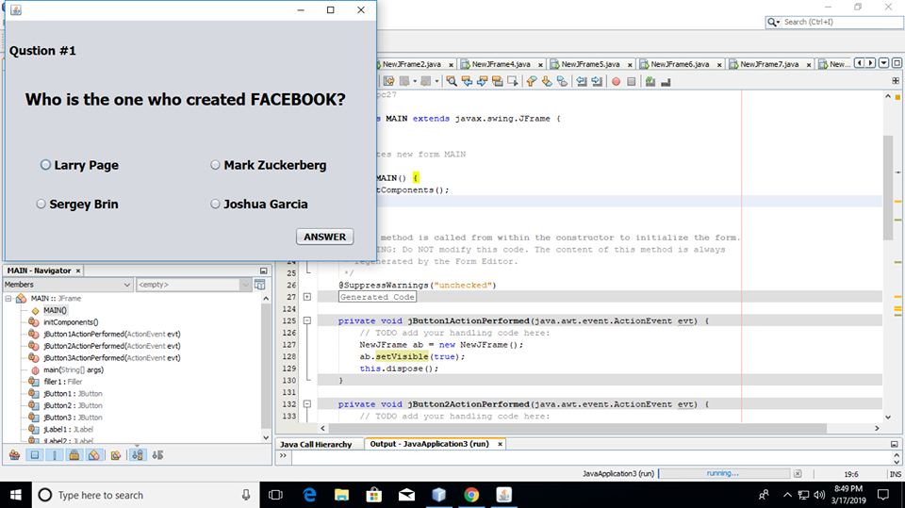
THIS COULD BE THE OUTCOME DISPLAYED WHEN YOU START TO ANSWER THE FOLLOWING QUESTIONS. IT FORMS LIKE THIS AND YOU ARE GIVEN BY FOUR CHOICES.

Slide 6
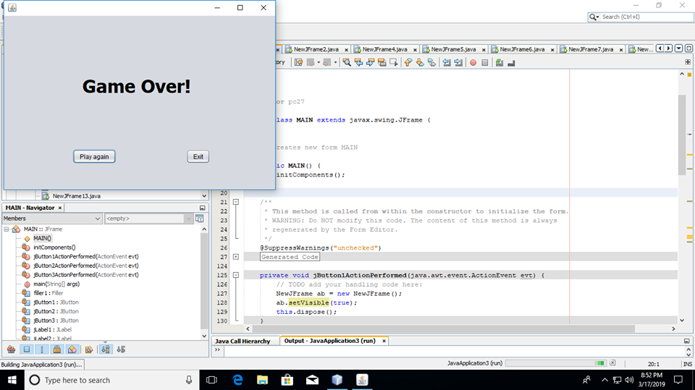
THIS OUTCOME WILL DISPLAY IF EVER YOU CHOOSE THE WRONG ANSWER.

Slide 7
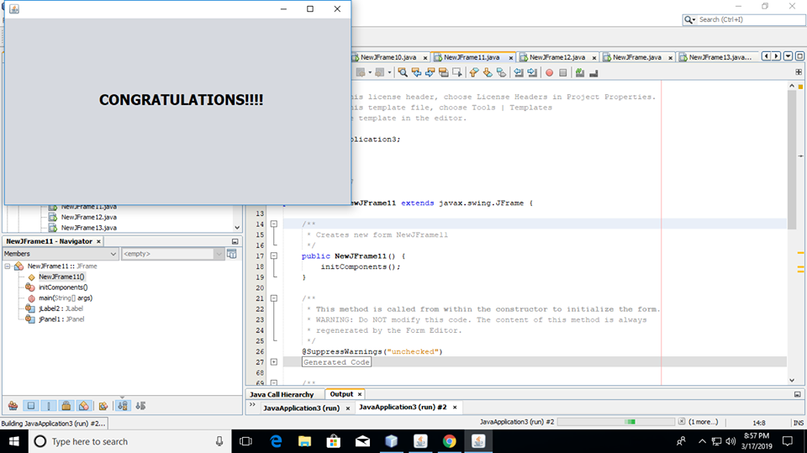
THIS OUTCOME WILL ALSO DISPLAY IF EVER YOU ANSWER THE FOLLOWING QUESTIONS CORRECT. AND THIS COULD BE THE MEAN THAT YOU WIN THE GAME.

Slide 8
THANK YOU!!!

